Slide 1
DSCI – 6011 DEEP LEARNING
BY
Saikrishna Chigicherla
Pavan Teja Sripati
Komal Tankashala

Slide 2
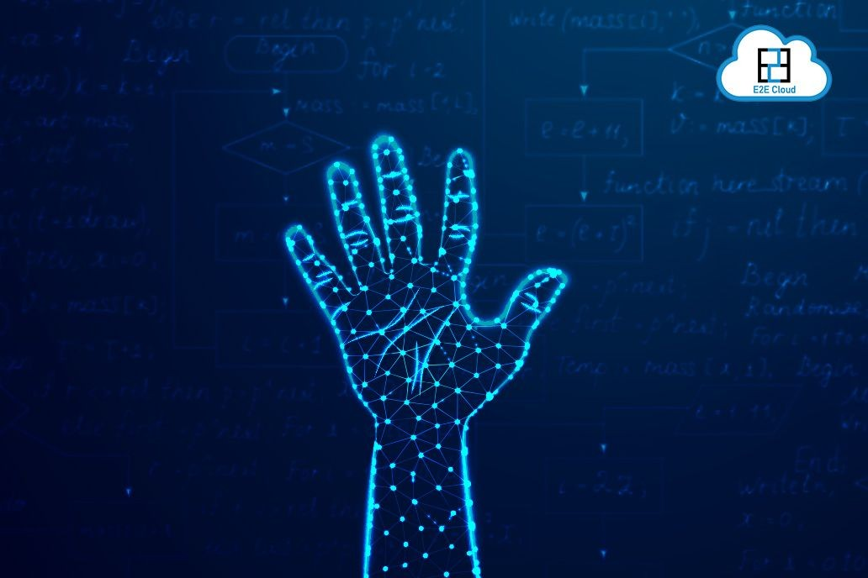
Hand Gesture Recognition for Sign Language Communication

Slide 3
OUTLINE
Statement of project objectives
Statement of value
Approach
Architectures reviews
Evaluation
References
Company performance
Future offerings
Roadmap
Competitive comparison
Our proposal
Next steps

Slide 4
Statement of project objectives
The project aims to develop a real-time sign language detection system using action recognition. It seeks to enhance communication accessibility for the deaf and hard-of-hearing by accurately classifying sign gestures and translating them into text or audio in real-time.

Slide 5
Statement of Value
This project is valuable as it aims to bridge communication gaps for the deaf and hard-of-hearing community by developing a real-time sign language detection system. By accurately interpreting sign gestures and enabling seamless translation, it fosters inclusivity, empowerment, and societal integration, ultimately improving quality of life.

Slide 6
Approach
Real Time Video
Architectures
Data Preparation
Train and Test
Evaluation

Slide 7
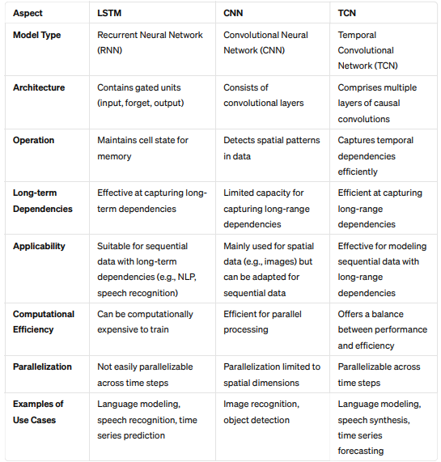
architectures we used

Slide 8
Evaluation
LSTM | CNN | TCN
Accuracy: 0.85416 | Accuracy: 0.9375 | Accuracy: 0.8750
F1 Score: 0.85663 | F1 Score: 0.9371 | F1 Score: 0.8732

Slide 9
Video demo
https://www.youtube.com/watch?v=Eb_N58HimtU

Slide 10
REFERENCES
[1] Kothadiya, D.; Bhatt, C.; Sapariya, K.; Patel, K.; Gil-González, A.-B.; Corchado, J.M. Deepsign: Sign Language Detection and Recognition Using Deep Learning. Electronics 2022, 11, 1780.
[2] Aman Pathak, Avinash Kumar, Priyam, Priyanshu Gupta and Gunjan Chugh. Real Time Sign Language Detection. International Journal for Modern Trends in Science and Technology 2022, 8 pp. 32-37.

Slide 11
THANK YOU

